Slide 1


Slide 2


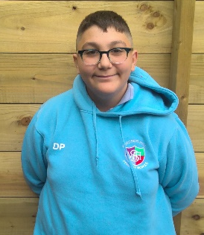
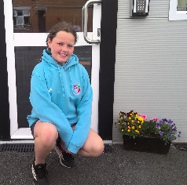
On a hot day in June
The sun will be so bright
That birds will be in flight
But those sunny days will soon end
And you’ll have to say goodbye to your dearest friends…
We need to think about the good times from Windsor Hill Primary School
‘COS
We love this school…..
When I first came in P3, I used to call Miss Henning professor. I barely knew any English.
Now I’m in P7 I can speak perfect English.

Slide 3
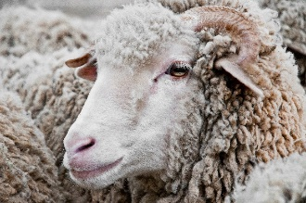

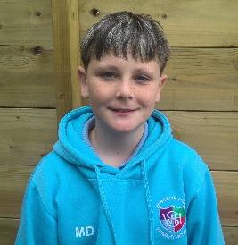
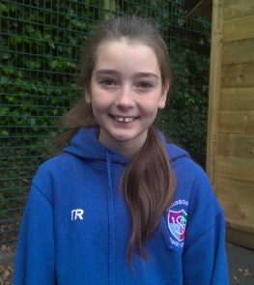
In P4, Uljana had a white coat, and she called it, ‘sheep.’ Cate, Uljana and myself ran around the MUGA calling it sheep and we all had a great laugh.
The Queen’s Jubilee was brilliant we all danced and danced.
During the Queen’s Julilee, David, Shannidhyo and me were playing and David and I fell in unison. Shannidhyo started laughing so much so that he fell beside us and we all laughed and laughed.

Slide 4
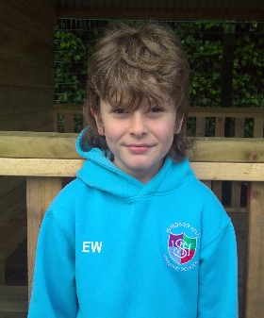
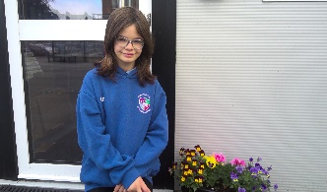
As the school year comes to an end,
We will have to say goodbye to some very dear friends,
Although starting a new school may be scary,
We don’t have to be weary.
Many friends will come and go,
But the memories we have will stay and grow,
Another of life's chapters we are passing through
Onto the next one – I’m excited, aren’t you?
My first hockey tournament was in Armagh. Even though we didn’t win I had a really fun time with the team.

Slide 5


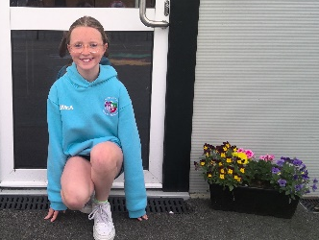
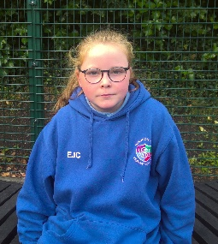
I loved going to Fort Evergreen in P1 and I enjoyed the train that was pulled by the tractor and playing with my friends.
I also loved being on the hockey and netball teams.
In P1 I met Katie-Rose and Paulina when both classes went to Fort Evergreen. We laughed and played and explored.
Paulina and I have a friendship that is everlasting.

Slide 6
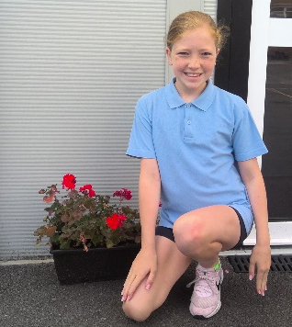
My favourite thing EVER… was when we had a teddy bear picnic in P1.
I had a crocheted zebra that my mum made for me when I was a baby.
It was a day I will always remember.
In P1 we went to Fort Evergreen, and I sat beside Katelynn while the little train took us on a drive around.

Slide 7
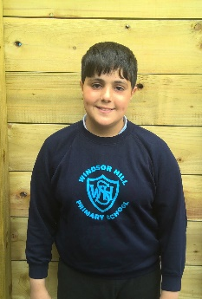
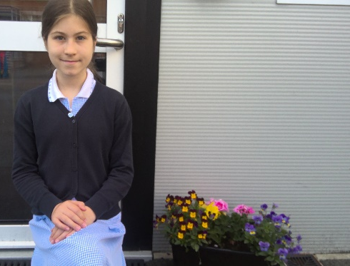
When I was in P1, a girl told everyone to catch me, and I remember everyone chasing me. I ran so fast, but I did get caught.
Although fun times don’t last forever, I will still remember the friends I’ve been with every school day. They are Skye, Katie-Rose, Ellie Jayne and Zlata.

Slide 8
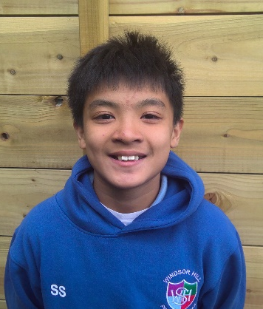
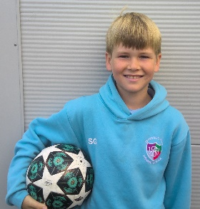
In P5, I drew a terrible angel and all my friends including myself laughed at how bad it was, and we just couldn’t stop even when the teacher asked us to.
I’ll never forget the great friends that I have made and the fun we have had.
When I was in P5, I loved making a huge Lego tower with Solomon, Erik and Oliver.
This has to be one of my favourite days at the start of my time in Windsor Hill.

Slide 9

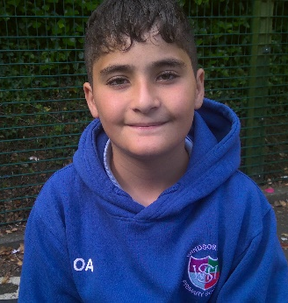
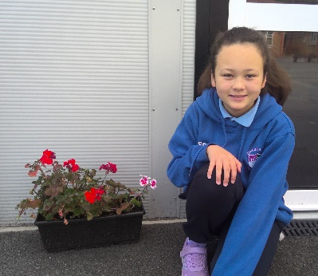
My favourite part of school has always been taking part in World Book Day as well as art and ICT lessons.
I have made some great friends and met some nice teachers.
I liked all the trips we went on.
My best trip ever in Primary school was going to Shannagmore.

Slide 10
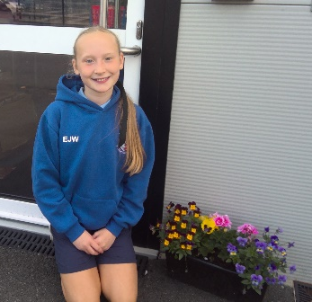
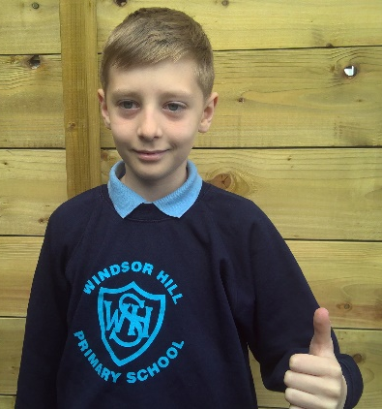
I remember in P1 when we went to Fort Evergreen we went on the train and had lots of fun.
I made new friends.
I loved it.
In P2 I remember making my first two friends – Alex and Danny.

Slide 11

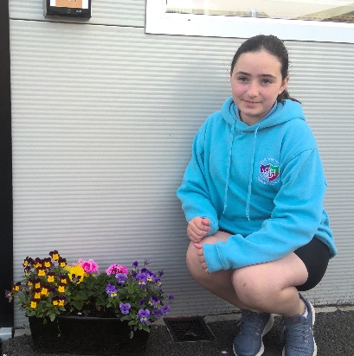
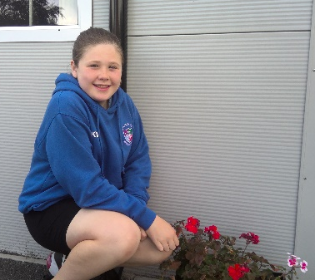
I will always remember when I first met all my friends in P1.
Now I am leaving P7, I will always remember the fun we had when we went away to Shannaghmore together.
My favourite memory from my time in Windsor Hill must be going to Shannaghmore. I loved the rock climbing.

Slide 12
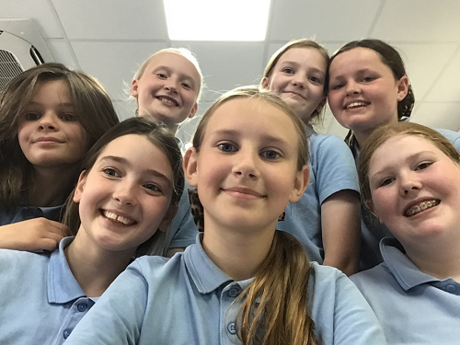
On my first day in P1, I licked a toy ice-cream and played in the shop.
I will always remember the Queen’s Jubilee and the fun we had playing all the games especially Lydia, Cate and Alesha.
When I was in P4 we went to the Palace Stables about World War Two. I had lots of fun there.
Carlos

Slide 13
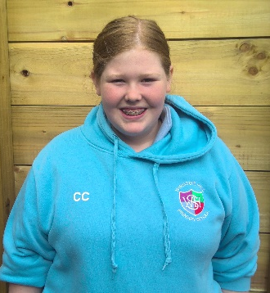
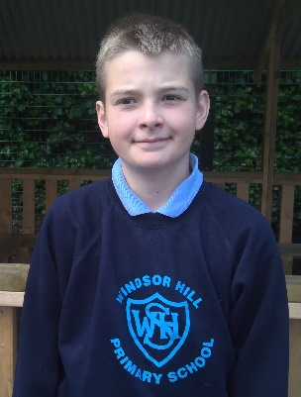
I love playing netball and in one of our tournaments in P7 we came 3rd. I will always remember how happy the team was with this result.
My best memory is when I went on a trip in P2 to Fort Evergreen. It was the first time I had ever travelled on a bus.

Slide 14
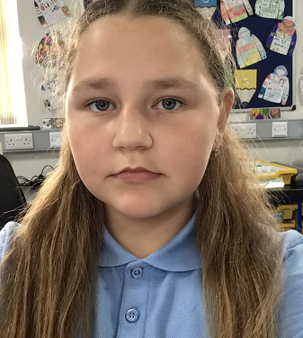
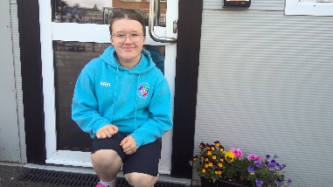
I joined Windsor Hill in P7 and have made some good friends. They are Katie-Rose, Paulina, Skye and Maria.
My new teacher Mrs Kerrigan is nice, and Miss Malone and Mrs McDowell helped me a lot.
I love school and I like playing with Skye, Paulina, Ellie-Jayne, Maria and Zlata.
I really loved going to Shannaghmore and swimming when we went bouldering.

Slide 15
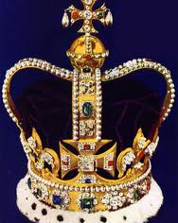
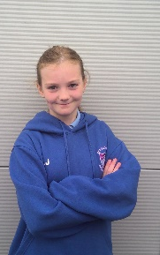
In P1, Uljana and I loved to play in the sandpit especially throwing sand at each other.
I will always remember celebrating the Queens Jubilee when I was in P3. Uljana, Alesha, Cate and I danced and danced and then we all got ice cream.
I enjoy using the iPad for learning games and playing with my friends.
Zahir

Slide 16
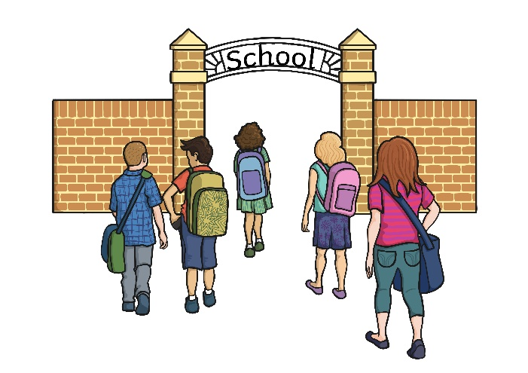
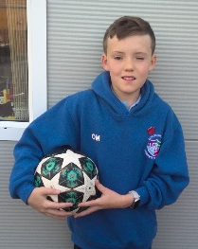
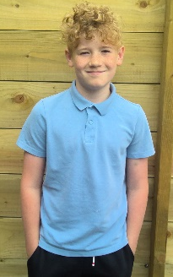
One day at lunch in P2, I accidently hit Ethan with my Frube yoghurt stick and it exploded on his head. We laughed and laughed. I don’t think we will ever forget this.
I will always remember the fun football matches I had with my friends.

Slide 17
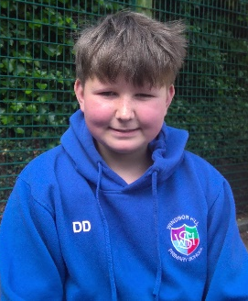
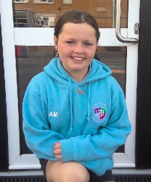
In P1, we made chocolate apples, and I ate mine walking out the doors.
No matter what we did in school I always remember taking time to play with Uljana, Cate and Lydia. I also loved netball with Miss Nesbitt and Miss McKeown.
In P2 we went on a trip. I loved everything that we did that day.

Slide 18
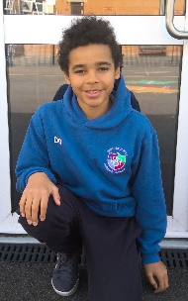
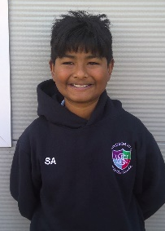
One day in P7, Michael and I were playing with my yellow squishy ball at break time. Michael threw it with full power at the fence, and it exploded with white stuff going everywhere. We just laughed and laughed.
I loved going to Shannagmore and taking part in all the activities.
I also loved playing Minecraft on the iPads.

Slide 19
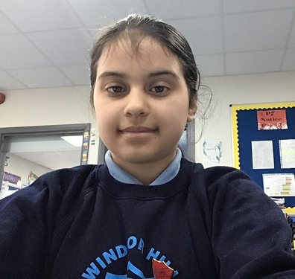
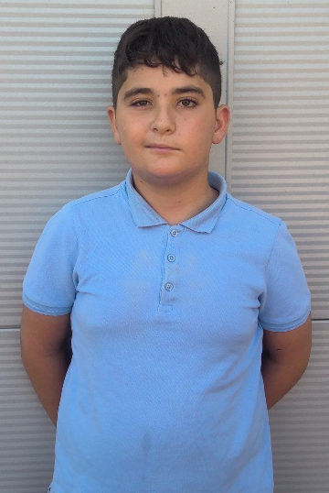
Playing in the sand box in P1 and P2 meant I always came home covered in sand.
I will never forget the time we went to Shannaghmore.
I enjoyed the ropes course and bouldering.
I made lots of great memories with my friends.
I have lots of fun memories with my friends Katie-Rose, Zlata, Daniel and Samuel.
I am going to miss school when I leave.

