Slide 1

Feelings

Slide 2
What do we know about feelings?
Every one has the same types of feelings.
We can show feelings on the inside and the outside.
There are lots of different types of feelings.
Feelings can be comfortable or uncomfortable.
There’s no such thing as a bad feeling.
All feelings are OK to have.

Slide 3
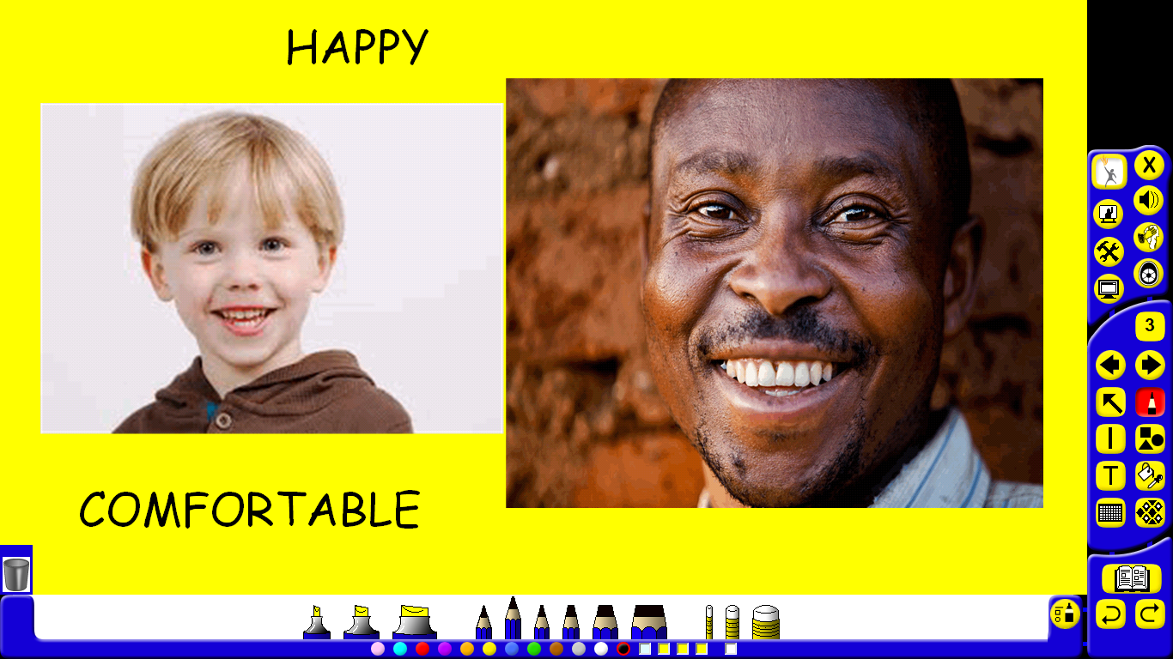

Slide 4
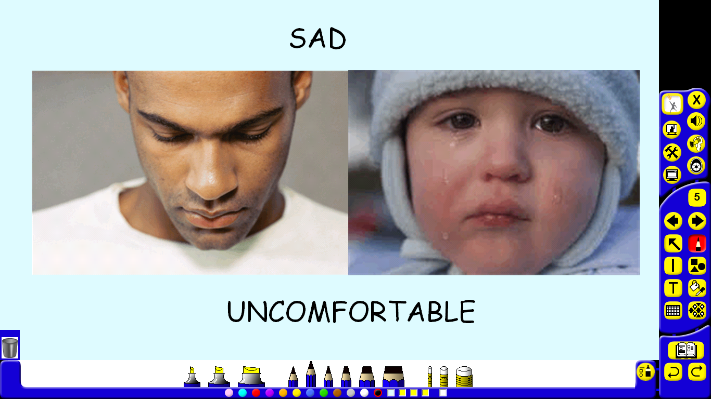

Slide 5
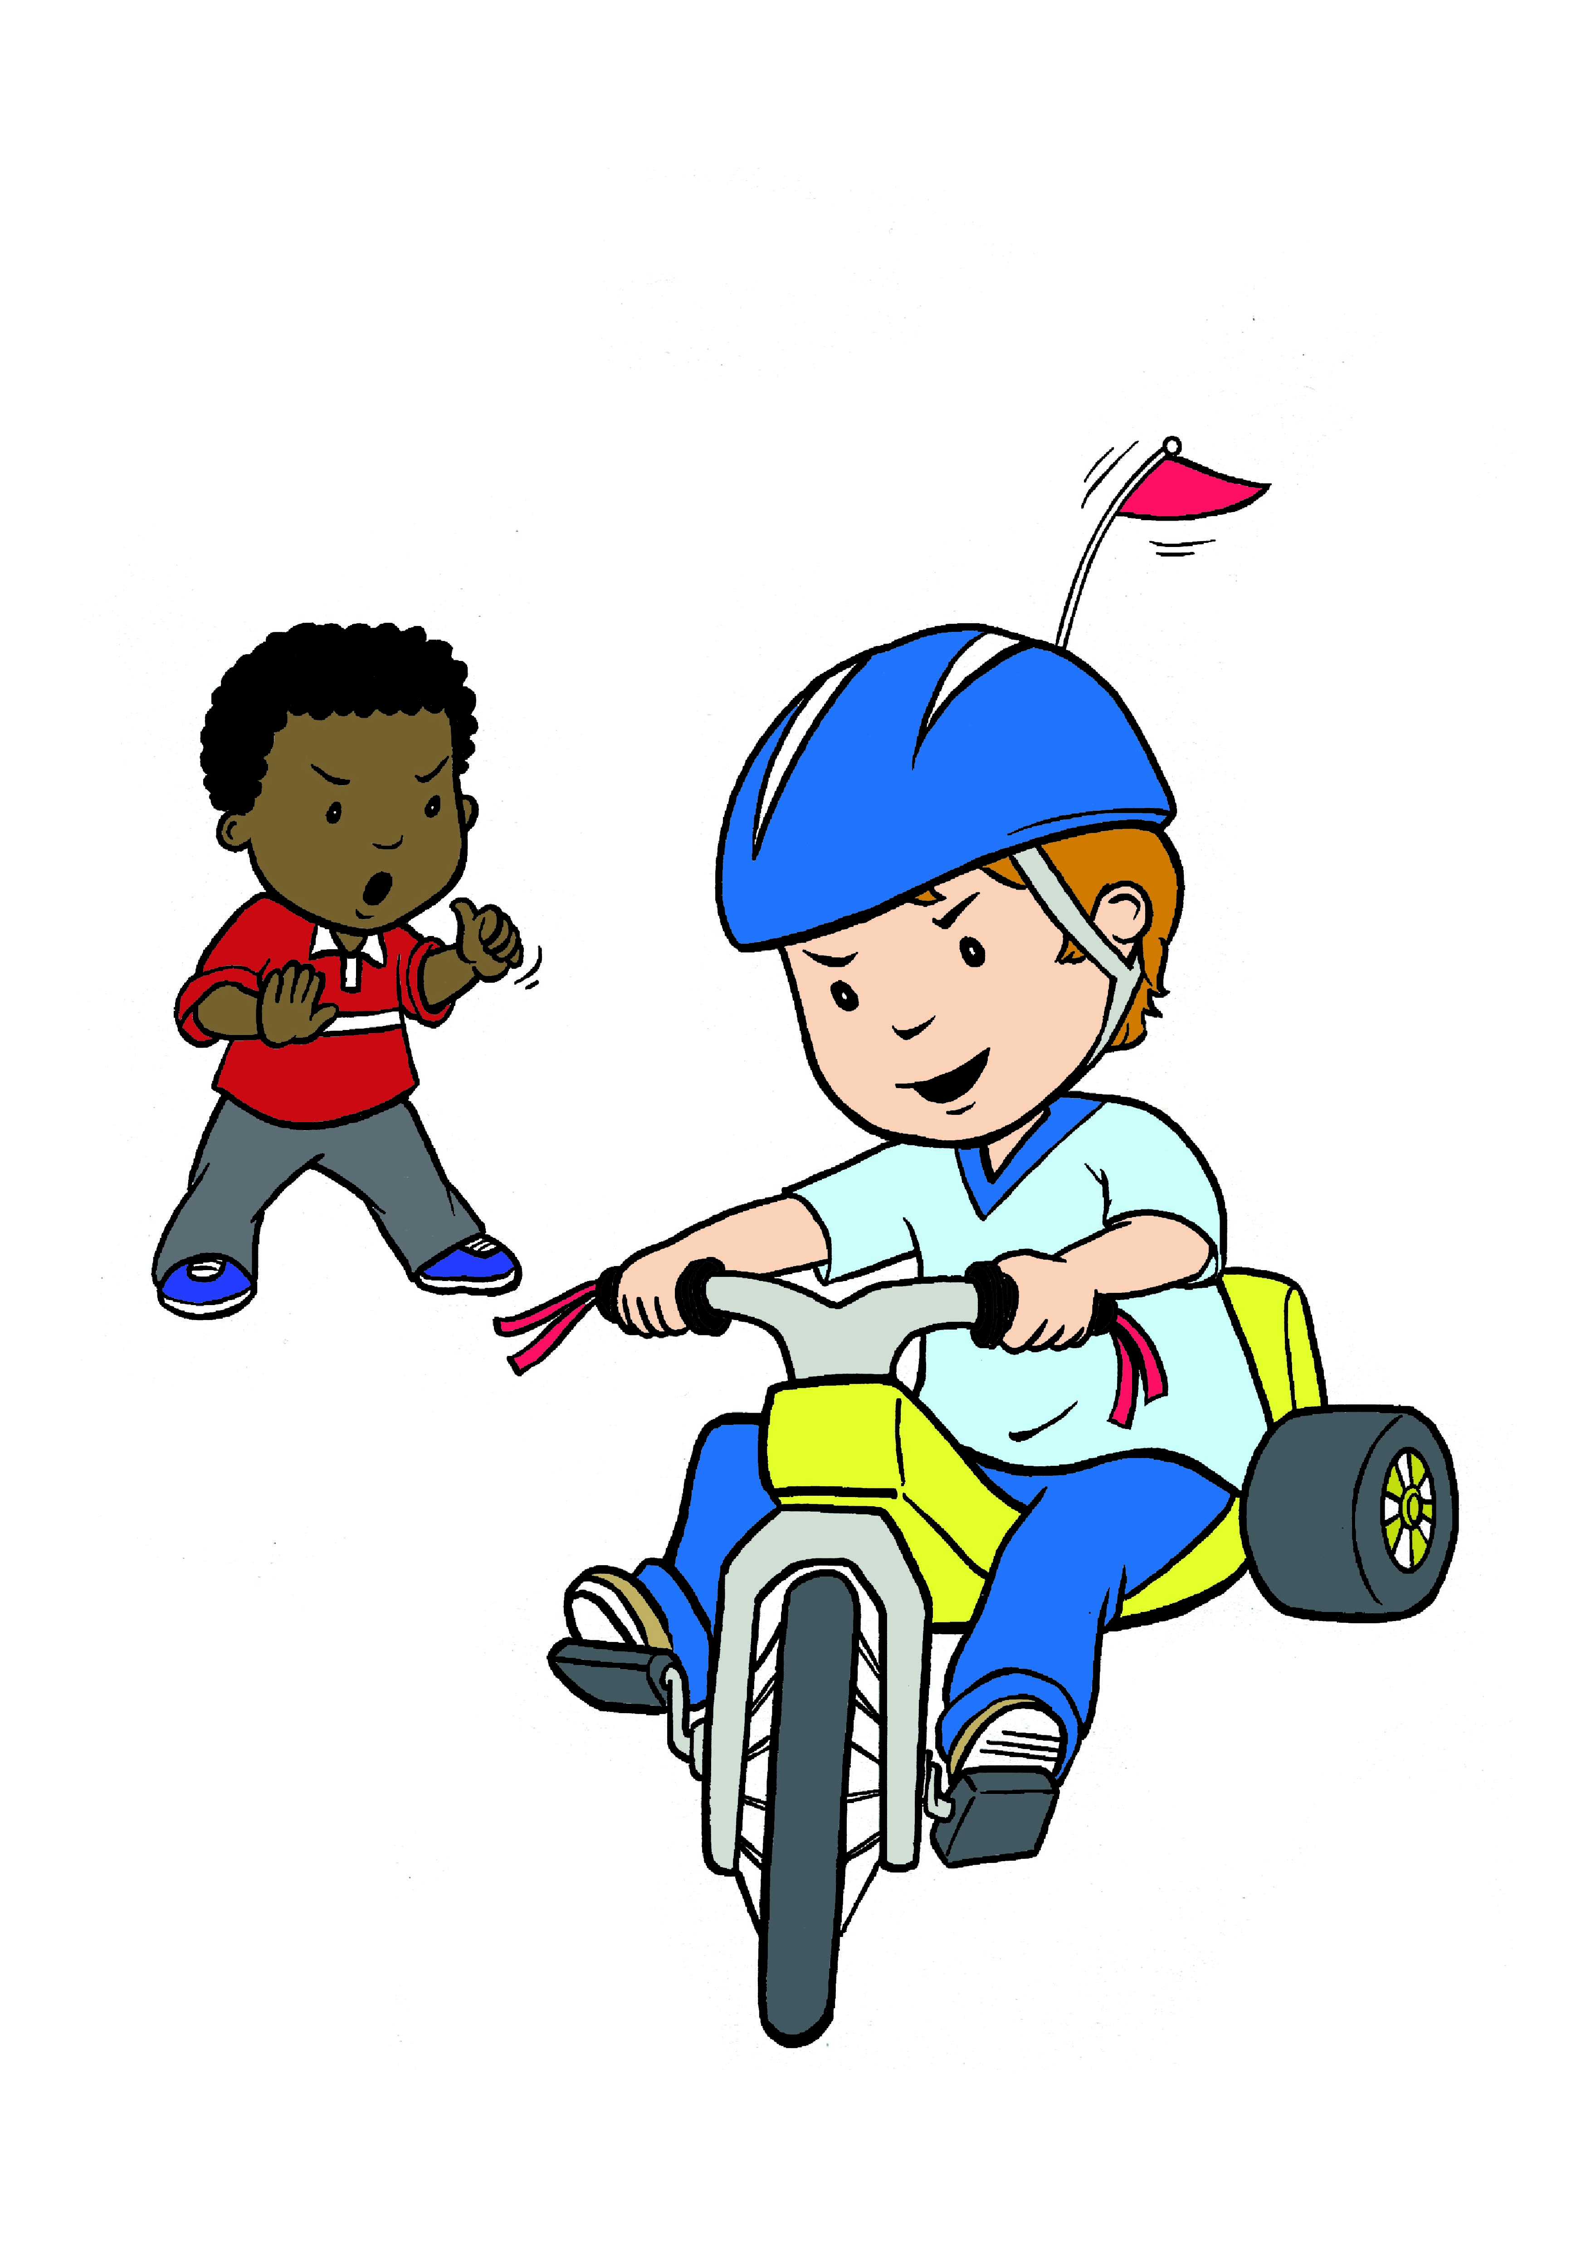
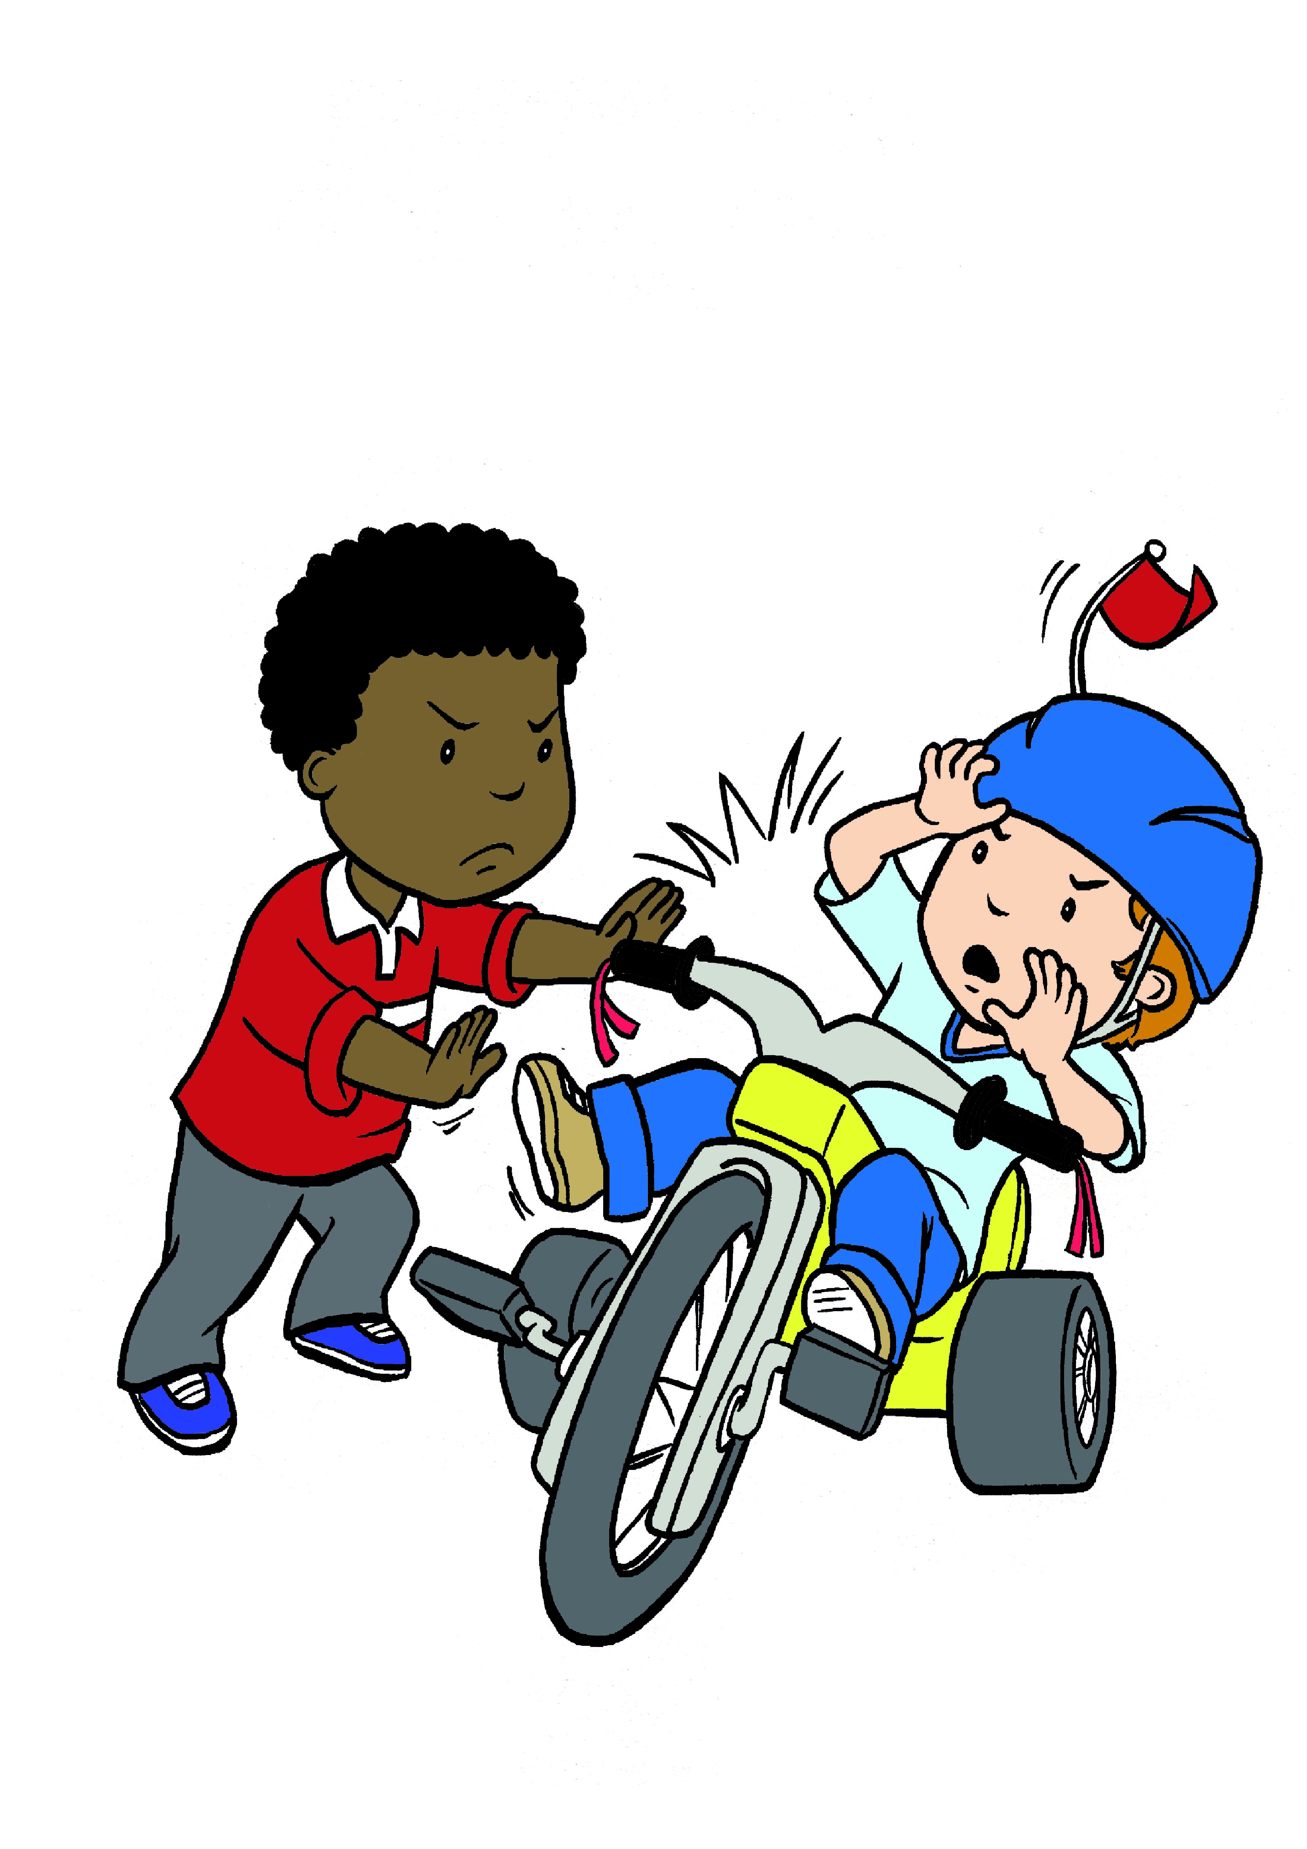
Behaviours and Feelings
Its OK to feel Its NOT OK
cross

Slide 6
We have learned that:
Feelings are very important
Feelings tell us what is going on around us and inside us
If we pay attention to our feelings, they can help us understand things
EVERYONE has feelings all the time!!

